Slide 1
VL53L1X 2D-LIDAR Schematics
Imaging Americas
Version 1.0

Slide 2
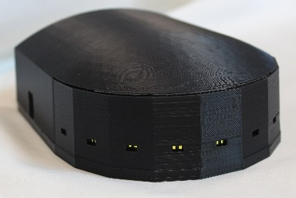
Finished Product

Slide 3
Items Needed
1 - Nucleo-F401RE
5 – VL53L1X-SATEL (this contains two VL53L1 Satellite Boards)
2 – 4.7K resistors (preferably Through Hole versions)
1 – 3D Printed Plastic of “Lidar Base CES Version.stp”
1 – 3D Printed Plastic of “Lidar Top CES Version.stp”

Slide 4
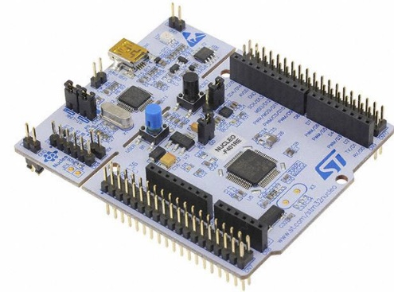
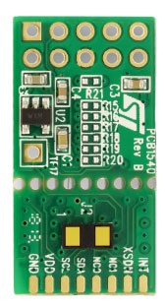
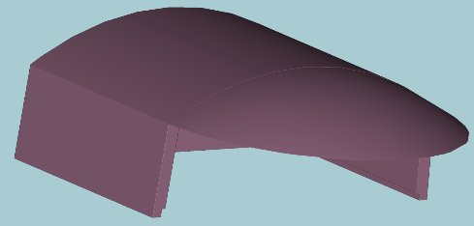
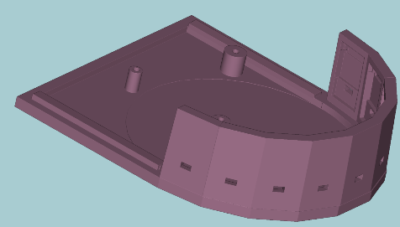
Items Needed
Nucleo-F401RE
VL53L1X-SATEL
Top Plastic
Base Plastic

Slide 5
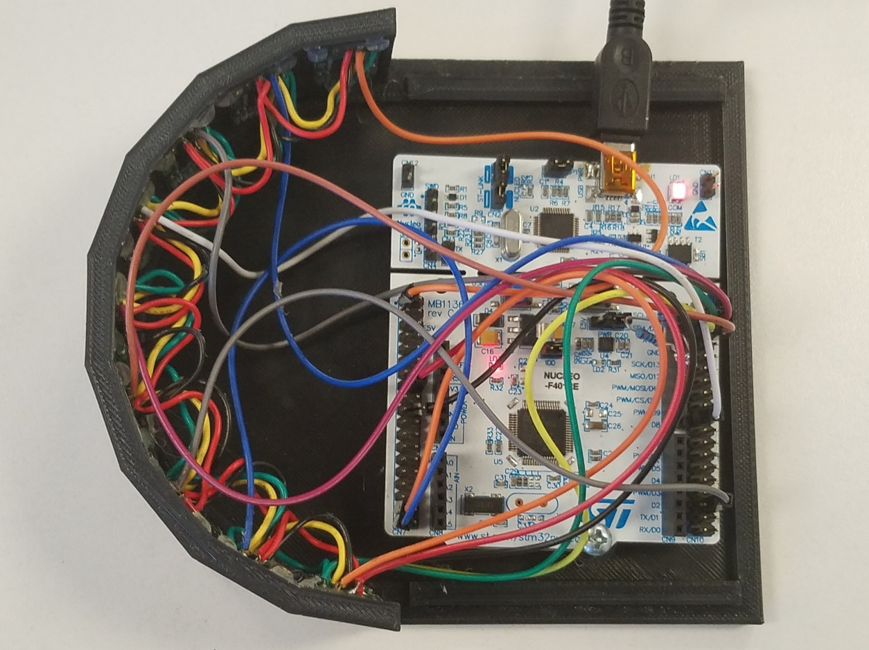
Wiring Diagram
Sensor 1
Sensor 2
Sensor 3
Sensor 4
All Sensor boards share the same I2C SCL, I2C SDA, Power and GND pins.
Only the Reset pin has its own connection to the Nucleo board to ensure that each device has its own I2C address at initialization.
Sensor 5
Sensor 6
Sensor 7
Sensor 8
Sensor 9

Slide 6
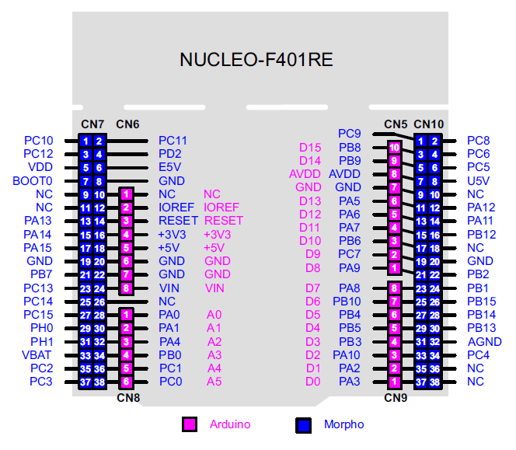
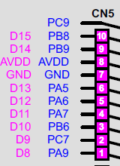
Wiring Diagram
Reset Pins from STM32 to Each Satellite Board
Sensor 1 - GPIO PC2 (Pin 35 of CN7)
Sensor 2 - GPIO PC3 (Pin 37 of CN7)
Sensor 3 - GPIO PC4 (Pin 34 of CN10)
Sensor 4 - GPIO PC5 (Pin 6 of CN10)
Sensor 5 - GPIO PC6 (Pin 4 of CN10)
Sensor 6 - GPIO PC7 (Pin 19 on CN10)
Sensor 7 - GPIO PC8 (Pin 2 of CN10)
Sensor 8 - GPIO PC9 (Pin 21 of CN10)
Sensor 9 - GPIO PC10 (Pin 1 of CN7)
I2C Pins to each Satellite board
PB8 – SCL (Pin 3 of CN10)
PB9 – SDA (Pin 5 of CN10)
4.7K
4.7K
(Please note that 4.7K Pullup Resistors are needed on each of these I2C pins for the I2C to operate. Connect other end of the resistor to AVDD (pin 8 of CN5)
Power and GND Pins
Power – Pin 16 of CN6
GND – Pin 20 of CN6

Slide 7
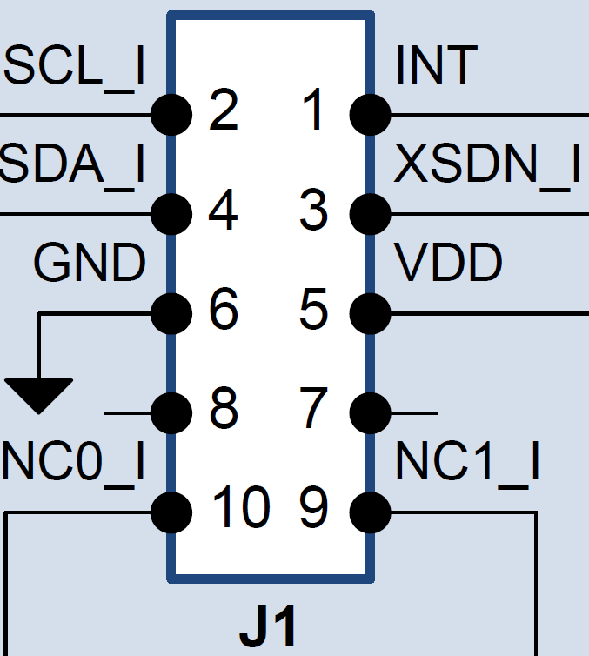
Wiring Diagram
SCL Pin goes to Pin 3 of CN10 for all 9 boards
SDA Pin goes to Pin 5 of CN10 for all 9 boards
Reset Pin Separate GPIO Pin on STM32
(Example: Sensor 1 goes to GPIO PC2 on Nucleo Board)
Power Pin goes to Pin 16 of CN6 for all 9 boards
GND Pin goes to Pin 20 of CN6 for all 9 boards

